Slide 1
Efficienet kernel wITH DPC++
ZhuWei, IAGS/MLP/TF GPU

Slide 2
Agenda
Background
Efficient Kernel with DPC++
Q&A

Slide 3
Agenda
Background
Efficient Kernel with DPC++
Q&A

Slide 4
Work Background : TF SoftWare Stack
Tensorflow Framework
Device
Ops
Graph
DPC++ Device
Onednn kernels
DPC++ kernels
LLGA Graph
DPC++ Runtime
Onednn xpu impl
DPC++ Compiler
LLGA xpu impl
XPU Hardware
CPU
GPU
FPGA
FLEXIBLE, CUSTOME DESIGN
Notes:
要总结下dpc++是直接编程工具，DPC++要大写，Device要写在graph前面

Slide 5
Work Backgroud
Functionality
Op Converage:
Enabled 49 ops in dev branch, helped to raise op coverage from 64.39% to 91.62%, met 2020 goal.
Enabled 20+ ops in Plugin brach.
Performance(WIP)
Model analysis: rn50, bert
Custom Kernel benchmark and Optimization
Kernel not supported by Onednn(NMS, L2loss, AdamMomentum and so on)
Fusion outside oneDNN
Notes:
要总结下dpc++是直接编程工具，

Slide 6
Agenda
Background
Efficient Kernel with DPC++
Migration from CUDA to DPC++
Case study : GEMM optimization
Q&A

Slide 7




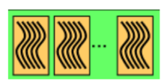

Migration from CUDA to DPC++: Execution Model
Software
Hardware
CUDA | DPC++
SP | Process Element
SM | Compute Unit
Thread | Work item
Block | Work group
Grid | NDRange
Thread/Work Item
SP/EU
Block/Work Group
SM/DSS
Grid/NDRange
GPU Device

Slide 8
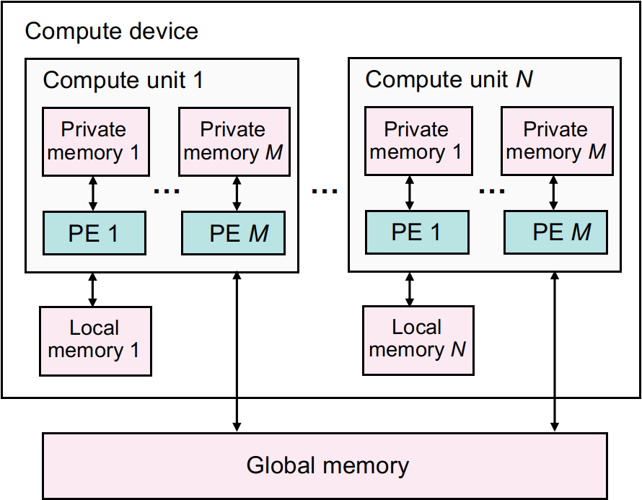
Migration from CUDA to DPC++: Memory Model
CUDA | DPC++
Local memory | Private memory
Shared memory | Local memory
Global memory | Global memory
Constant memory | Constant memory
Notes:
备注：cuda memory object中texture memory可以去掉

Slide 9
Efficient Kernel with DPC++
Case study : GEMM optimization
Notes:
Benchdnn的peak和理论的peak

Slide 10
What is Our Optimization Goal
Strive to reach GPU peak performance
Choose the right metrics:
GFLOP/s: for compute-bound kernels
Bandwidth: for memory-bound kernels
Gemm have high arithmetirc intensity
Therefore strive for peak GFLOP/s
Use DG1 for this example
96 EUs, 8 threads/EU, 1100 MHz Clock Frequency
96 * 8 * 1.1 * 2 = 1689 GFLOP/s（Roofline）

Slide 11
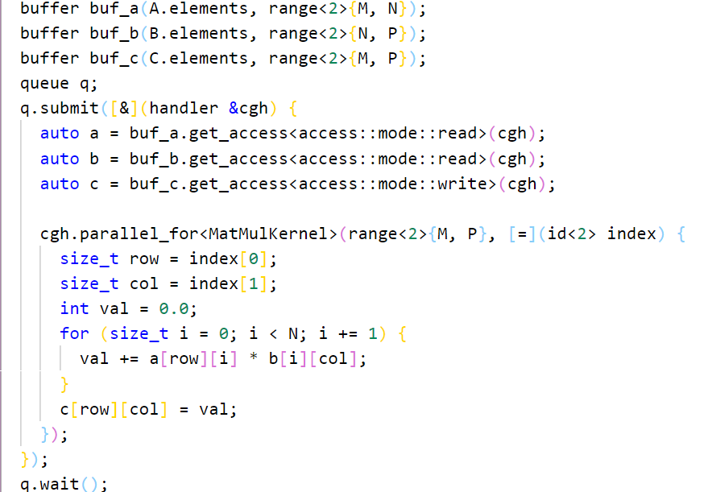
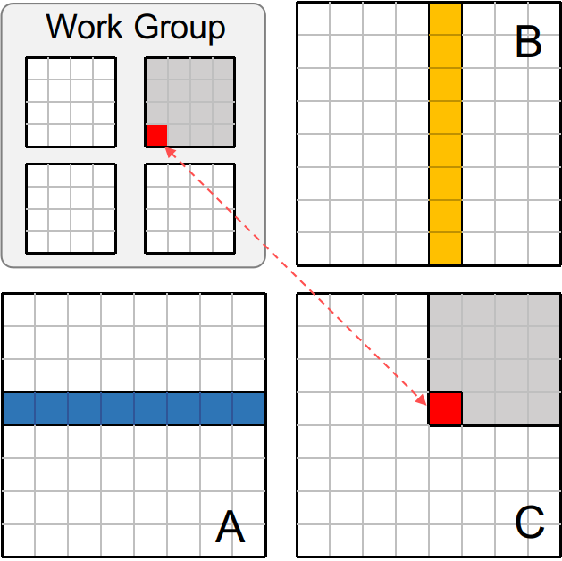
GEMM #1: Start with DPC++
sycl::malloc_shared
sycl::malloc_device
sycl::aligned_alloc_device

Slide 12
Performance
version | Gflops | Time (ms) | Step Speedup | Cumulative Speedup | Efficiency
v1 | 141.52 | 29.63 | 1.0x | 1.0x | 8%
Peak | 1689 | 2.49 | - | -
Note: Performance with Matrix size 1280*1280

Slide 13
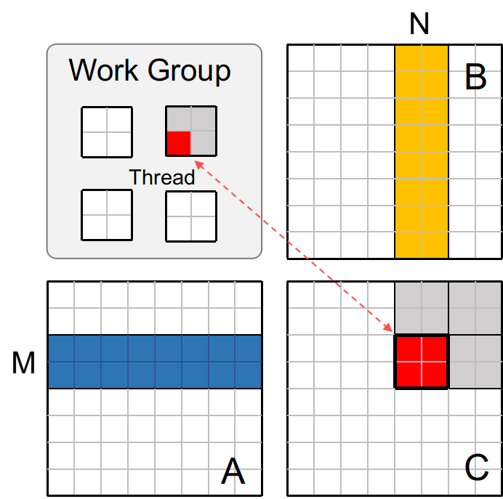
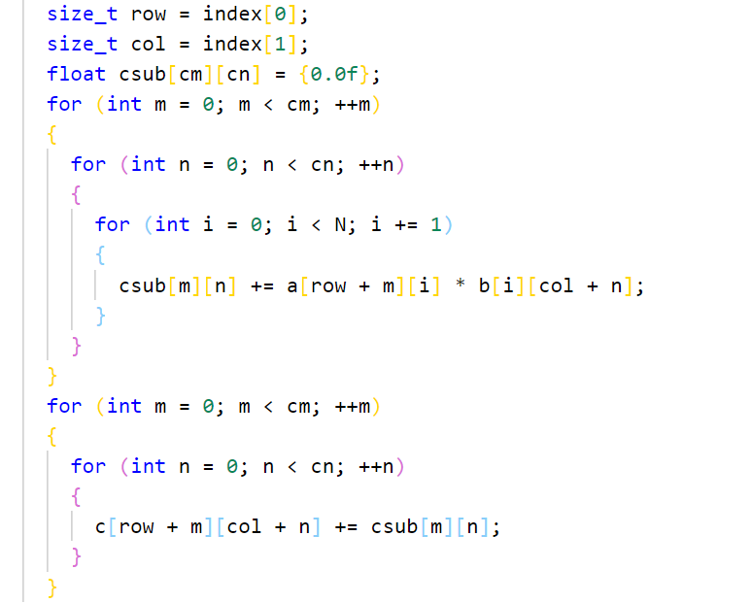
GEMM #2: Multiple Outputs per Thread
Try to increasing cache utilization
Notes:
这张ppt是画一个线程计算m*n个元素的，已经从显存读入数据，如果只算一个，就有点浪费，所以可以考虑多算几个，这样减少显存的访问次数。

Slide 14
Performance
version | Gflops | Time (ms) | Step Speedup | Cumulative Speedup | Efficiency
v1 | 141.52 | 29.63 | 1.0x | 1.0x | 8%
v2 | 71.83 | 58.39 | 0.51x | 0.51x | 4.2%
Why performance drop a lot?
Multiple outputs per thread result in less parallelism and latency can’t be hided

Slide 15
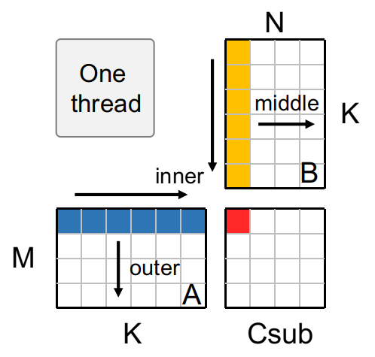
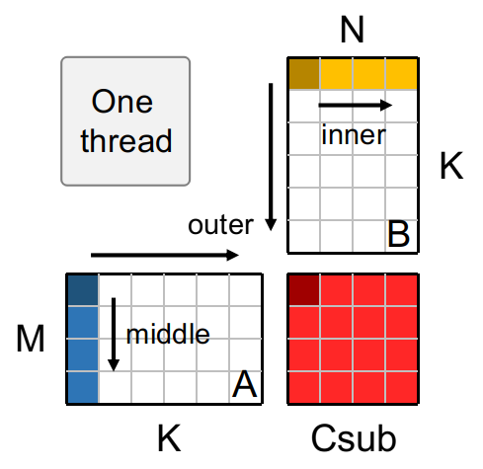
GEMM #3: Multiple Outputs per Thread -- Permute
for (int m = 0; m < cm; m++) {
for (int n = 0; j < cn; n++) {
for (int i = 0; i < K; i++) {
c[m][n] += a[row + m][i] * b[i][col + n];
}
}
}
Reduce memory repeat access
Increase L2 cache hit rate
Notes:
提高cache命中率

Slide 16
Performance
version | Gflops | Time (ms) | Step Speedup | Cumulative Speedup | Efficiency
v1 | 141.52 | 29.63 | 1.0x | 1.0x | 8.3%
v2 | 71.83 | 58.39 | 0.51x | 0.51x | 4.2%
v3 | 609.09 | 6.88 | 8.47x | 4.31x | 36%
Peak | 1689 | 2.49 | - | -

Slide 17
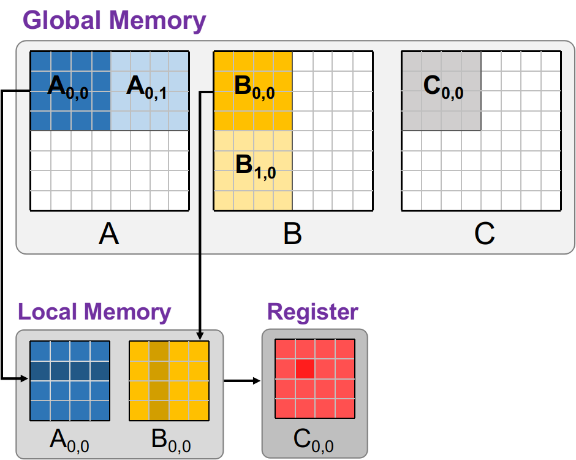
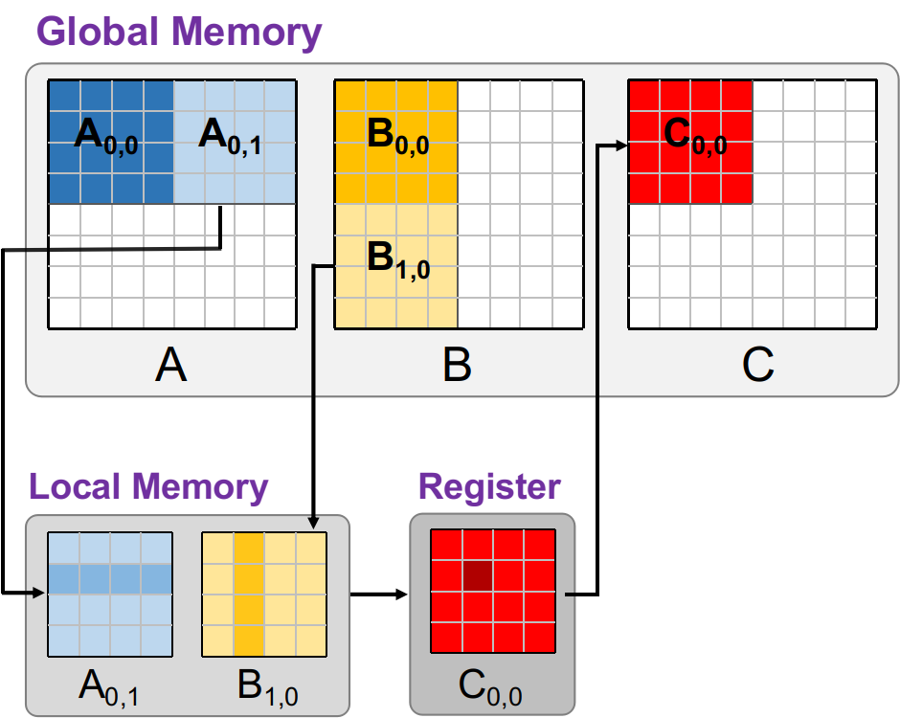
GEMM #4: Using Local Memory
Local memory is allocated per work group
User-managed data caches
Access to Local memory is much faster than global memory
Notes:
为了达到高带宽，Shared Memory被划分成许多大小相同的内存块，叫做Banks。Banks可以同步访问，即不同的地址对不同的Banks可以同时读写。但是，如果两个内存请求的地址落到同一个Bank上，将会导致Bank Conflicts，严重影响并行程序的性能。

Slide 18
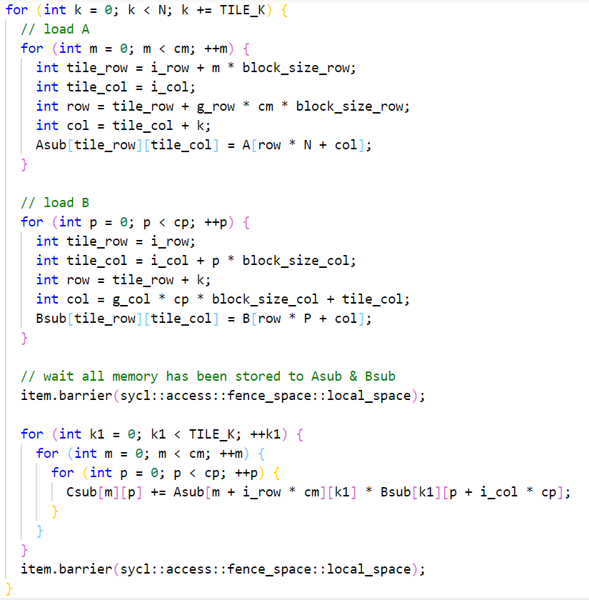
GEMM #4: Using Local Memory

Slide 19
Performance
version | Gflops | Time (ms) | Step Speedup | Cumulative Speedup | Efficiency
v1 | 141.52 | 29.63 | 1.0x | 1.0x | 8.3%
v2 | 71.83 | 58.39 | 0.51x | 0.51x | 4.2%
v3 | 609.09 | 6.88 | 8.47x | 4.31x | 36%
v4 | 982.14 | 4.27 | 1.61x | 6.96x | 58%
Peak | 1689 | 2.49 | - | -

Slide 20
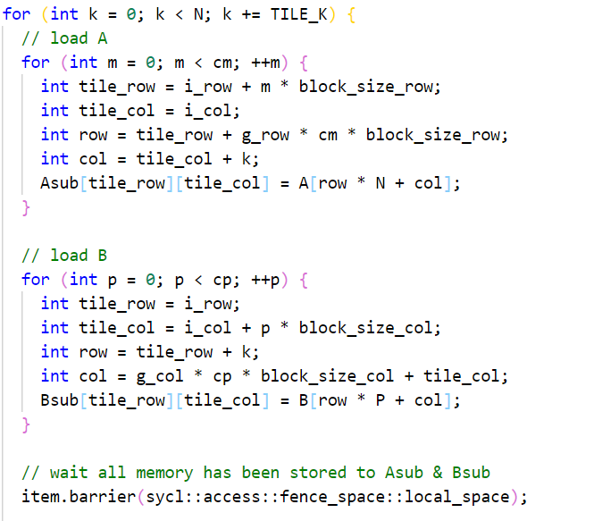
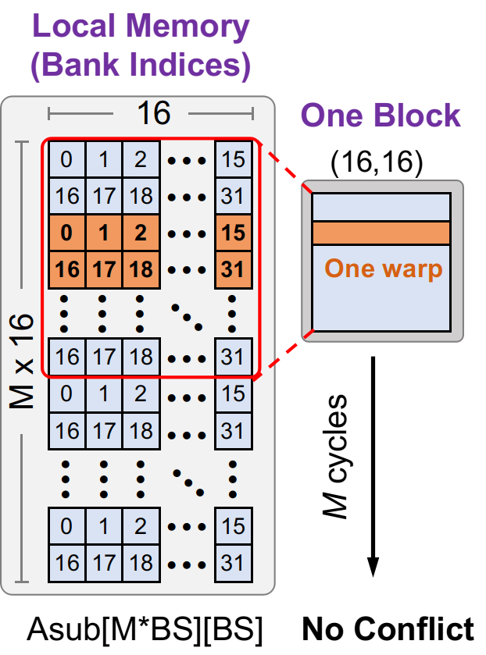
GEMM #5: Local Memory -- Bank Conflicts

Slide 21
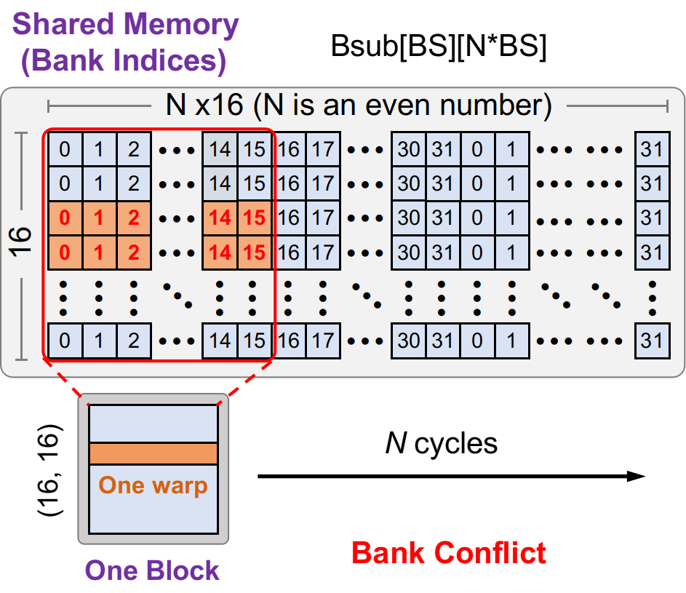
GEMM #5: Local Memory -- Bank Conflicts
Different threads in one warp access “different” words in the same bank.

Slide 22
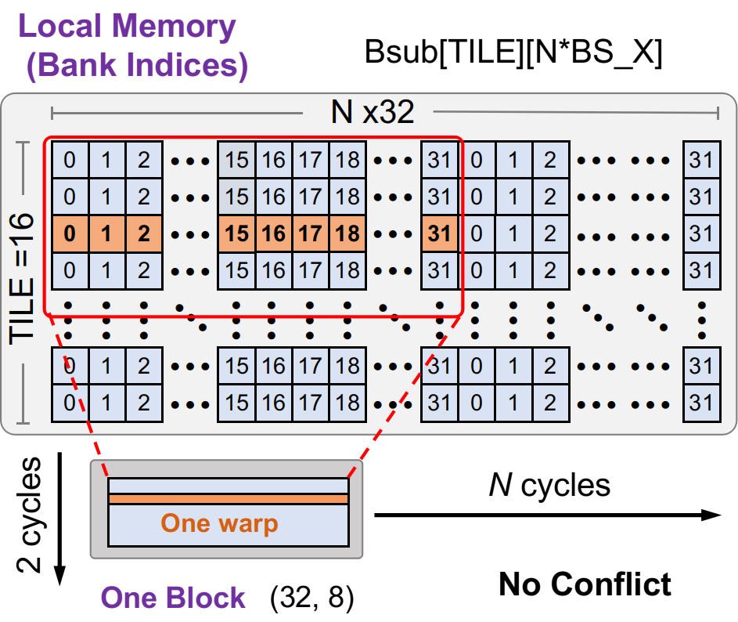
GEMM #5: Local Memory -- Bank Conflicts free
#define BLOCK_SIZE_X 16
#define BLOCK_SIZE_X 32

Slide 23
Performance
version | Gflops | Time (ms) | Step Speedup | Cumulative Speedup | Efficiency
v1 | 141.52 | 29.63 | 1.0x | 1.0x | 8.3%
v2 | 71.83 | 58.39 | 0.51x | 0.51x | 4.2%
v3 | 609.09 | 6.88 | 8.47x | 4.31x | 36%
v4 | 982.14 | 4.27 | 1.61x | 6.96x | 58%
v5 | 1048.73 | 3.99 | 1.06x | 7.43x | 62%
Peak | 1689 | 2.49 | - | -

Slide 24
What to do Next?
At v5 1048GFLOP/s, we’re 62% Efficency.
Next Step
Vectorization: using float4
Reduce instruction overhead: unroll loops
Tuning
Trying Finding Cause Proving

Slide 25
Conclusion
Use peak performance metrics to guide optimization
Understand performance characteristrics
Latency hiding
Bank conflict
Try to identify the type of bottleneck
Using profiling tool: vtune
Memory, core computation, or instruction overhead
Learn more about Hardware
Look into the assembly code
Notes:
Vtune 的hotspot

Slide 26
Thank You！

